Slide 1
Hadoop
Basic Concepts and Working

Slide 2
Prerequisites
Local Machine having
8 GB RAM 64MB in all computers.
Virtual Machine having
Ubuntu 14.4 installed
Root password
ssh on port 22 is up and running
This can be test with the following command
ssh localhost and enter the password , it should go through.
If not please install ssh server and client with the following commands
sudo apt-get install openssh-server
sudo apt-get install openssh-client
Basic Java and Linux commands

Slide 3
Introduction
Big Data
Map Reduce
Hadoop
Components
Working
Hands-on: Simple exercises

Slide 4
Big Data
What is Big Data?
Three V’s
Volume
Variety
Velocity
A fourth V has been added recently “Veracity”

Slide 5

IBM BIGDATA DEFINITION

Slide 6
WHAT IS BIGDATA
Lots of data (Terabytes or Petabytes)
Enterprises generate huge amount of data from Terabytes to and even Petabytes of information.
Posts to social media sites
Sensors used to gather climate information
Digital pictures and videos posted online
Insight into data can provide business advantage
Some key early indicators can mean fortunes to business
More precise analysis with more data

Slide 7
THE 3 V’s of BIGDATA
Volume: 12 terabytes of Tweets created each day
Velocity: Scrutinize 5 million trade events created each day to identify potential fraud
Variety: Sensor data, audio, video, click streams, log files and more

Slide 8
Traditional vs Distributed
Traditionally, computation has been processor-bound
Relatively small amounts of data
Significant amount of complex processing performed on that data
Earlier processing power was bottleneck
Data moves from Database to the processing engine
Large amounts of data
Simple processing

Slide 9
LIMITATIONS OF EXISTING TECHNOLOGIES
BI Reports + Interactive Apps
Processing
A meagre 10% of the 2PB Data is available for BI
RDBMS (Aggregated Data)
1. Can’t explore original high fidelity raw data.
EPL Compute Grid
2. Moving data to compute doesn’t scale
90% of the 2PB archived
Storage only Grid (original Raw Data)
Storage
3. Premature data death
Mostly Append
Collection

Slide 10
Traditional vs Distributed
Scale Vertically
Increase the server capacity
Increase memory and processing power
Very costly (Eg. Terabyte server)
Scale Horizontally
Increase number of nodes that process the data
Cheap commodity hardware
Map-Reduce allows parallel processing

Slide 11
WHY ALL THIS ?
Limitation of existing IT infrastructure and resources
Vertical scalability is not always the solution: upgrading server and storage
RDBMS is not designed to scale out
Can not handle unstructured data
A new approach to the problem is required
Process structured and unstructured data
Analyze huge data sets running into several tera bytes or peta bytes
Process and manage data economically

Slide 12
HADOOP ADVANTAGE
BI Reports + Interactive Apps
1. Data Exploration & Advanced analytics
No Data Archiving
Entire 2PB Data is available for processing
RDBMS (Aggregated Data)
2. Scalable throughout for ETL & aggregation
Hadoop: Storage + Compute Grid
Mostly Append
3. Keep Data Alive forever
Both Storage And Processing
Collection
Instrumentation

Slide 13
Distributed Environment Requirements
Partial Error Recovery: The system must support partial failure
Failure of a component should result in a graceful degradation of application performance
Not complete failure of the entire system
Data Recoverability: If a component of the system fails, its workload should be assumed by still-functioning units in the system
Failure should not result in the loss of any data

Slide 14
Distributed Environment Requirements
Component Recovery: If a component of the system fails and then recovers, it should be able to re-join the system
Without requiring a full restart of the entire system
Consistency: Component failures during execution of a job should not affect the outcome of the job

Slide 15
Distributed Environment Requirements
Scalability: Adding load to the system should result in a graceful decline in performance of individual jobs
Not failure of the system
Increasing resources should support a proportional increase in load capacity

Slide 16
Hadoop
Hadoop is an open-source project overseen by the Apache Software Foundation
Originally based on papers published by Google in 2003 and 2004
Hadoop committers work at several different organizations
Including Cloudera, Yahoo!, Facebook

Slide 17
HADOOP –WHY IS IT DIFFERENT ?
Accessible
Simple
Robust
Scalable

Slide 18
Hadoop
Hadoop has following components
Components
Daemons
HDFS –Storage
Map Reduce for processing
Name Node
Secondary Name node
Data Node
Job Tracker
Task Tracker

Slide 19
HDFS
HDFS -Key Design Principles
HDFS -Building Blocks
Name Node & Data Node
Deployment modes
HDFS commands

Slide 20
HDFS
HDFS, the Hadoop Distributed File System, is responsible for storing data on the cluster
Data is split into blocks and distributed across multiple nodes in the cluster
Each block is typically 64MB or 128MB in size
Each block is replicated multiple times
Default is to replicate each block three times
Replicas are stored on different nodes
This ensures both reliability and availability

Slide 21
HDFS Building Blocks
File is split into multiple chunks and stored
Each chunk is called BLOCK
HDFS block sizes are large-64 MB
Why large block size?
Hadoop does not access one record at a time, it has to process all data
Keeping block size large keeps number of disk transfers to low
Map Reduce processes one block at a time
Blocks are replicated across multiple machines
By default it stores 3 copies of each block in separate machines at any point of time

Slide 22
HDFS – Basic Concepts
HDFS is a file system written in Java
Based on Google’s GFS
Sits on top of a native filesystem such as ext3, ext4 or xfs
Provides redundant storage for massive amounts of data
Using cheap, unreliable computers
HDFS performs best with a ‘modest’ number of large files
Millions, rather than billions, of files
Each file typically 100MB or more
Files in HDFS are ‘write once’
No random writes to files are allowed
HDFS is optimized for large, streaming reads of files Rather than random reads

Slide 23
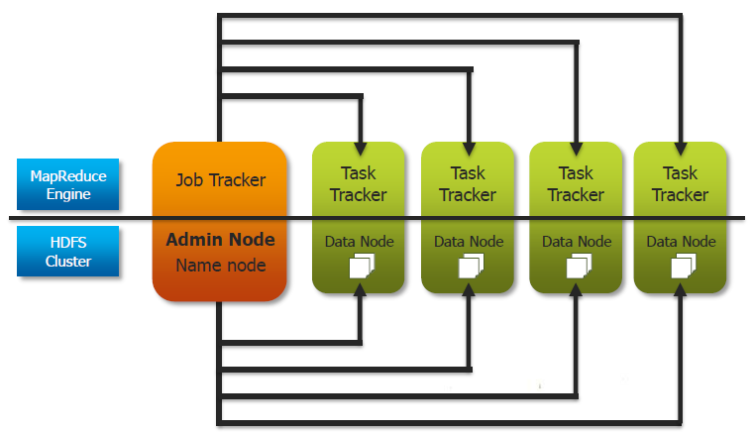
Hadoop Components

Slide 24
HDFS – NameNode and DataNode
Name Node manages the file system namespace
Stores the metadata of all the file and directory details
Knows what data nodes and the blocks of files they store
Without Name Node, HDFS is unusable
To withstand failure write metadata to multiple disks or local disk and NFS
Secondary Name Node is NOT an automatic failover system
Merges namespace with the edit log
Recover from Name Node failure

Slide 25
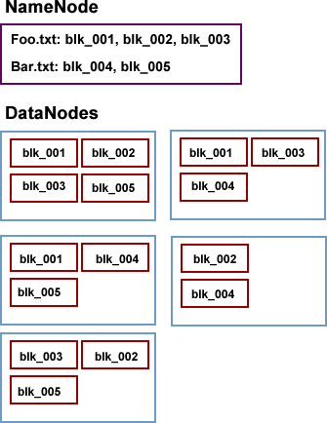
HDFS – NameNode and DataNode

Slide 26
HDFS - NameNode
The NameNode daemon must be running at all times
If the NameNode stops, the cluster becomes inaccessible
Your system administrator will take care to ensure that the NameNode hardware is reliable!
The NameNode holds all of its metadata in RAM for fast access
It keeps a record of changes on disk for crash recovery
A separate daemon known as the Secondary NameNode takes care of some housekeeping tasks for the NameNode
Be careful: The Secondary NameNode is not a backup NameNode!

Slide 27
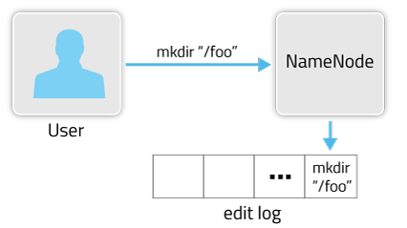
NameNode Concepts And Checkpointing

Slide 28
HDFS – Points to Note
Although files are split into 64MB or 128MB blocks, if a file is smaller than this the full 64MB/128MB will not be used
Blocks are stored as standard files on the DataNodes, in a set of directories specified in Hadoop’s configuration files
This will be set by the system administrator
Without the metadata on the NameNode, there is no way to access the files in the HDFS cluster
When a client application wants to read a file:
It communicates with the NameNode to determine which blocks make up the file, and which DataNodes those blocks reside on
It then communicates directly with the DataNodes to read the data
The NameNode will not be a bottleneck

Slide 29
hadoop fs Examples
Copy file foo.txt from local disk to the user’s directory in HDFS
This will copy the file to /user/username/foo.txt
Get a directory listing of the user’s home directory in HDFS
Get a directory listing of the HDFS root directory
hadoop fs -copyFromLocal foo.txt foo.txt
hadoop fs -ls
hadoop fs –ls /

Slide 30
hadoop fs Examples (cont’d)
Display the contents of the HDFS file /user/fred/bar.txt
Move that file to the local disk, named as baz.txt
Create a directory called input under the user’s home directory
Delete the directory input_old and all its contents
hadoop fs –cat /user/fred/bar.txt
hadoop fs –copyToLocal /user/fred/bar.txt baz.txt
hadoop fs –mkdir input
hadoop fs –rmr input_old

Slide 31
What Is MapReduce?
MapReduce is a method for distributing a task across multiple Nodes
Each node processes data stored on that node
Where possible
Consists of two phases:
Map
Reduce

Slide 32
Features of MapReduce
Automatic parallelization and distribution
Fault-tolerance
Status and monitoring tools
A clean abstraction for programmers
MapReduce programs are usually written in Java
Can be written in any scripting language using Hadoop Streaming
All of Hadoop is written in Java
MapReduce abstracts all the ‘housekeeping’ away from the developer
Developer can concentrate simply on writing the Map and Reduce functions

Slide 33
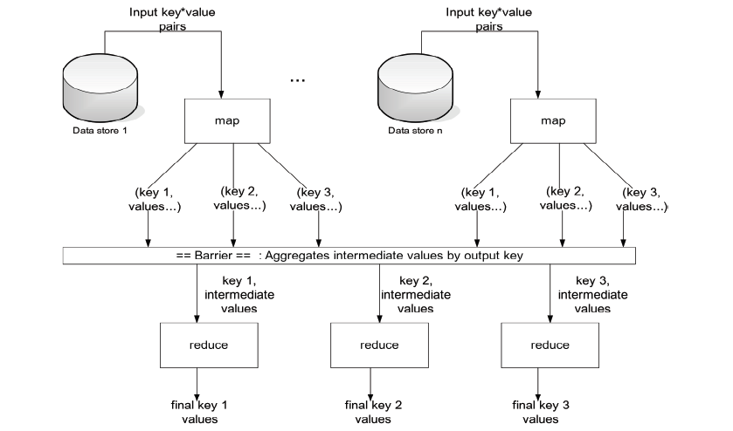
MapReduce: The Big Picture

Slide 34
MapReduce: The JobTracker
MapReduce jobs are controlled by a software daemon known as the JobTracker
The JobTracker resides on a ‘master node’
Clients submit MapReduce jobs to the JobTracker
The JobTracker assigns Map and Reduce tasks to other nodes on the cluster
These nodes each run a software daemon known as the TaskTracker
The TaskTracker is responsible for actually instantiating the Map or Reduce task, and reporting progress back to the JobTracker

Slide 35
MapReduce: Terminology
A job is a ‘full program’
A complete execution of Mappers and Reducers over a dataset
A task is the execution of a single Mapper or Reducer over a slice of data
A task attempt is a particular instance of an attempt to execute a task
There will be at least as many task attempts as there are tasks
If a task attempt fails, another will be started by the JobTracker
Speculative execution (see later) can also result in more task attempts than completed tasks

Slide 36
MapReduce: The Mapper
Hadoop attempts to ensure that Mappers run on nodes which hold their portion of the data locally, to avoid network traffic
Multiple Mappers run in parallel, each processing a portion of the input data
The Mapper reads data in the form of key/value pairs
It outputs zero or more key/value pairs
map(in_key, in_value) -> (inter_key, inter_value) list

Slide 37
MapReduce: The Mapper (cont’d)
The Mapper may use or completely ignore the input key
For example, a standard pattern is to read a line of a file at a time
The key is the byte offset into the file at which the line starts
The value is the contents of the line itself
Typically the key is considered irrelevant
If the Mapper writes anything out, the output must be in the form of key/value pairs

Slide 38
Example Mapper: Upper Case Mapper
Turn input into upper case (pseudo-code):
Let map (k, v) =
emit (k. toUpper (), v. toUpper () )
(‘foo’, ‘bar’) -> (‘FOO’, ‘BAR’)
(‘foo’, ‘other’) -> (‘FOO’, ‘OTHER’)
(‘BAZ’, ‘more data’) -> (‘BAZ’, ‘MORE DATA’)

Slide 39
Example Mapper: Explode Mapper
Output each input character separately (pseudo-code):
Let map (k, v) =
foreach char c in v:
emit (k. c)
(‘foo’, ‘bar’) -> (‘foo’, ‘b’), (‘foo’, ‘a’), (‘foo’, ‘r’)
(‘foo’, ‘other’) -> (‘foo’, ‘o’), (‘foo’, ‘t’),
(‘foo’, ‘h’), (‘foo’, ‘e’),
(‘foo’, ‘r’)

Slide 40
Example Mapper: Filter Mapper
Only output key/value pairs where the input value is a prime number (pseudo-code):
let map(k, v) =
if (isPrime(v)) then emit(k, v)
('foo', 7) -> ('foo', 7)
('baz', 10) -> nothing

Slide 41
Example Mapper: Changing Keyspaces
The key output by the Mapper does not need to be identical to the input key
Output the word length as the key (pseudo-code):
let map(k, v) =
emit(v.length(), v)
('foo', 'bar') -> (3, 'bar')
('baz', 'other') -> (5, 'other')
('foo', 'abracadabra') -> (11, 'abracadabra')

Slide 42
MapReduce: The Reducer
After the Map phase is over, all the intermediate values for a given intermediate key are combined together into a list
This list is given to a Reducer
There may be a single Reducer, or multiple Reducers
This is specified as part of the job configuration
All values associated with a particular intermediate key are guaranteed to go to the same Reducer
The intermediate keys, and their value lists, are passed to the Reducer in sorted key order
This step is known as the ‘shuffle and sort’
The Reducer outputs zero or more final key/value pairs
These are written to HDFS
In practice, the Reducer usually emits a single key/value pair for each input key

Slide 43
Example Reducer: Sum Reducer
Add up all the values associated with each intermediate key (pseudo-code):
let reduce(k, vals) =
sum = 0
foreach int i in vals:
sum += i
emit(k, sum)
(’bar', [9, 3, -17, 44]) -> (’bar', 39)
(’foo', [123, 100, 77]) -> (’foo', 300)

Slide 44
Example Reducer: Identity Reducer
The Identity Reducer is very common (pseudo-code):
let reduce(k, vals) =
foreach v in vals:
emit(k, v)
('foo', [9, 3, -17, 44]) -> ('foo', 9), ('foo', 3),
('foo', -17), ('foo', 44)
('bar', [123, 100, 77]) -> ('bar', 123), ('bar', 100),
('bar', 77)

Slide 45
MapReduce Example: Word Count
Count the number of occurrences of each word in a large amount of input data
This is the ‘hello world’ of MapReduce programming
map(String input_key, String input_value)
foreach word w in input_value:
emit(w, 1)
reduce(String output_key,
Iterator<int> intermediate_vals)
set count = 0
foreach v in intermediate_vals:
count += v
emit(output_key, count)

Slide 46
MapReduce Example: Word Count (cont’d)
Input to the Mapper:
Output from the Mapper:
(3414, 'the cat sat on the mat')
(3437, 'the aardvark sat on the sofa')
('the', 1), ('cat', 1), ('sat', 1), ('on', 1),
('the', 1), ('mat', 1), ('the', 1), ('aardvark', 1),
('sat', 1), ('on', 1), ('the', 1), ('sofa', 1)

Slide 47
MapReduce Example: Word Count (cont’d)
Intermediate data sent to the Reducer:
Final Reducer output:
('aardvark', [1])
('cat', [1])
('mat', [1])
('on', [1, 1])
('sat', [1, 1])
('sofa', [1])
('the', [1, 1, 1, 1])
('aardvark', 1)
('cat', 1)
('mat', 1)
('on', 2)
('sat', 2)
('sofa', 1)
('the', 4

Slide 48
MapReduce: Data Localization
Whenever possible, Hadoop will attempt to ensure that a Map task on a node is working on a block of data stored locally on that node via HDFS
If this is not possible, the Map task will have to transfer the data across the network as it processes that data
Once the Map tasks have finished, data is then transferred across the network to the Reducers
Although the Reducers may run on the same physical machines as the Map tasks, there is no concept of data locality for the Reducers
All Mappers will, in general, have to communicate with all Reducers

Slide 49
MapReduce: Is Shuffle and Sort a Bottleneck?
It appears that the shuffle and sort phase is a bottleneck
The reduce method in the Reducers cannot start until all Mappers have finished
In practice, Hadoop will start to transfer data from Mappers to Reducers as the Mappers finish work
This mitigates against a huge amount of data transfer starting as soon as the last Mapper finishes

Slide 50
MapReduce: Is a Slow Mapper a Bottleneck?
It is possible for one Map task to run more slowly than the others
Perhaps due to faulty hardware, or just a very slow machine
It would appear that this would create a bottleneck
The reduce method in the Reducer cannot start until every Mapper has finished
Hadoop uses speculative execution to mitigate against this
If a Mapper appears to be running significantly more slowly than the others, a new instance of the Mapper will be started on another machine, operating on the same data
The results of the first Mapper to finish will be used
Hadoop will kill off the Mapper which is still running

Slide 51
MAP REDUCE
Key
Value
Map:
(K1, V1)
List (K2, V2)
MapReduce
Reduce:
(K2, list (V2))
List (K3, V3)

Slide 52
MAP REDUCE – ADVANTAGE
Two biggest Advantages:
Node
Taking processing to the data
Processing data in parallel
a
b
c
Rack

Slide 53
INPUT SPLITS
HDFS BLOCK
PHYSICAL
DIVISION
INPUT DATA
INPUT SPLITS
LOGICAL DIVISION

Slide 54
MAP REDUCE
Logical records do not fit neatly into the HDFS blocks.
Logical records are lines that cross the boundary of the blocks.
First split contains line 5 although it spans across blocks.

Slide 55
MAP REDUCE FLOW
Input data is distributed to nodes
Reducer output is stored
Each map task works on a “split” of data
Mapper outputs intermediate data
Intermediate data of the same key goes to the same reducer
Data exchange between nodes in a “shuffle” process

Slide 56
MAPPER
Reads data from input data split as per the input format
Denoted as Mapper<kl, vl, k2, v2>
kl, vl are key value pair of input data
K2, v2 are key value pair of output data
Hadoop will create k2 and List(v2) And give the data to Reducer.
Package : org.apache.hadoop.mapreduce

Slide 57
MAP REDUCE
Complete view of MapReduce, illustrating combiners and partitioners in addition to Mappers and Reducers
MapReduce
Combiners
Practitioners
Combiners can be viewed as ‘mini-reducers’ in the Map phase.
Partitioners determine which reducer is responsible for a particular key

Slide 58
MAPREDUCE - COMBINER
BCDEDB DAACBD
(B,1)
(C,1)
(D,1)
(E,1)
(D,1)
(B,1)
(D,1)
(A,1)
(A,1)
(C,1)
(B,1)
(D,1)
(B,2)
(C,1)
(D,2)
(E,1)
Block 1
Mapper
Combiner
(A,[2])
(B,[2,1])
(C,[1,1])
(D,[2,2])
(E,[1])
(A,2)
(B,3)
(C,2)
(D,4)
(E,1)
Shuffle
Reducer
(D,12
(A,2)
(C,1)
(B,1)
Block 2
Mapper
Combiner

Slide 59
MAPREDUCE PARTITIONER
Map
Reducer
Partitioner
Map
Reducer
Partitioner
Map
Reducer
Partitioner

Slide 60
MAPPER API
public class MyMapper extends Mapper<LongWritable, Text, Text, lntWritable>
<LogWritable, Text> key-value pair input to mapper
<Text,lntWritable> key-value pair output of mapper

Slide 61
Override map ( ) method
Public void map (Long Writable key, Text value, Context context) throws lO Exception, Interrupted Exception

Slide 62
MAP REDUCE EXAMPLE
Input
Splitting
Mapping
Shuffling
Reducing
Final Result
K2, List (V2)
K1,V1
List (K2, V2)
Bear, (1,1)
Combiner
Deer, 1
Bear, 1
River, 1
Deer Bear River
Car, (1,1,1)
Combiner
List (K3,V3)
Dear Bear River Car Car River Deer Car Bear
Car, 1
Car, 1
River, 1
Bear, 2
Car, 3
Deer, 2
River, 2
Car CarRiver
Deer, (1,1)
Combiner
Deer, 1
Car, 1
Bear, 1
Deer Car Bear
River, (1,1)
Combiner

Slide 63
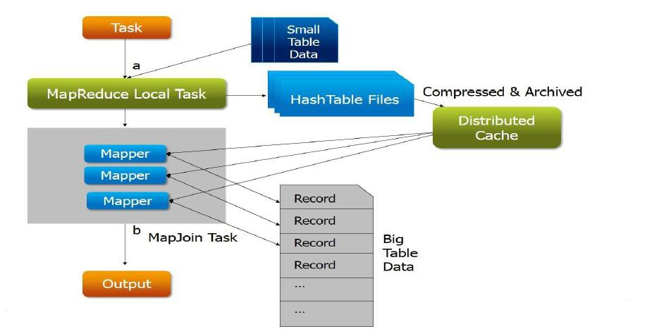
MAP AND REDUCE SIDE JOINS
Task
Compressed & Archived
MapReduce Local Task
Distributed Cache
MapJoin Task
Task
Big Table
Data

Slide 64
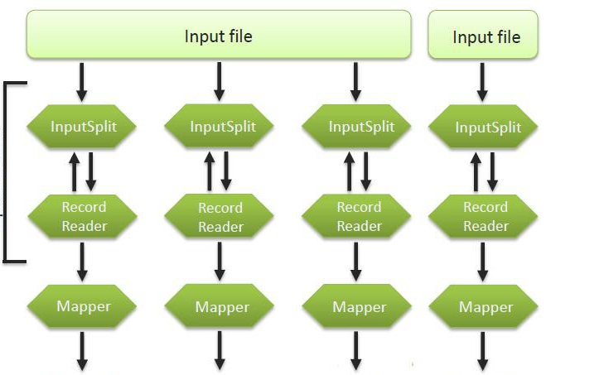
INPUT FORMAT
Input File
Input File
InputSplit
InputSplit
InputSplit
InputSplit
Input f0rmat
Record
Reader
Record
Reader
Record
Reader
Record
Reader
Mapper
Mapper
Mapper
Mapper
(Intermediates)
(Intermediates)
(Intermediates)
(Intermediates)

Slide 65
OUTPUT FORMAT
Reducer
Reducer
Reducer
Reducer
RecordWriter
RecordWriter
RecordWriter
RecordWriter
Output Format
Output File
Output File
Output File
Output File

Slide 66
OUTPUT FORMAT
TextOnputFormat
<K,V>
OnputFormat <K,V>
org.apache.hadoop.mapreduce
FileOnputFormat <K,V>
SequenceFile OutputFormat <K,V>
SequenceFileAs BinaryOnputFormat
NullOutputFormat <K,V>
DBoutputFormat <K,V>
FileOutputFormat <K,V>
LazyOutputFormat <K,V>

Slide 67
Map Reduce
One file is divided into multiple blocks
Done transparently by HDFS
Once the file is divided into blocks, each node can work on the blocks which it has available locally (sometimes remotely)
One Mapper/Reducer per block
One call to map() method for each record
One block/input split might contain multiple records
One Record might be split between two input splits, RecordReader takes care of such records

Slide 68
How Hadoop Does It?
Hadoop’s Map Reduce Framework has two major components
Job Tracker
Task Tracker
Job Tracker and Task Tracker are two Java modules which take care of Running a Map-Reduce-Kind of program over a number of cluster nodes
They keep programmer transparent of cluster and do the housekeeping for distributed computing

Slide 69
Job Tracker and Task Tracker
The primary function of the job tracker is resource management (managing the task trackers), tracking resource availability and task life cycle management (tracking its progress, fault tolerance etc.)
The task tracker has a simple function of following the orders of the job tracker and updating the job tracker with its progress status periodically.
The task tracker is pre-configured with a number of slots indicating the number of tasks it can accept. When the job tracker tries to schedule a task, it looks for an empty slot in the tasktracker running on the same server which hosts the datanode where the data for that task resides. If not found, it looks for the machine in the same rack. There is no consideration of system load during this allocation.
The TaskTrackers send out heartbeat messages to the JobTracker, usually every few minutes, to reassure the JobTracker that it is still alive

Slide 70
Job Tracker and Task Tracker
Job Performance - Hadoop does speculative execution where if a machine is slow in the cluster and the map/reduce tasks running on this machine are holding on to the entire map/reduce phase, then it runs redundant jobs on other machines to process the same task, and whichever task gets completed first reports back to the job tracker and results from the same are carried forward into the next phase
Fault Tolerance -
The task tracker spawns different JVM processes to ensure that process failures do not bring down the task tracker.
The task tracker keeps sending heartbeat messages to the job tracker to say that it is alive and to keep it updated with the number of empty slots available for running more tasks.
From version 0.21 of Hadoop, the job tracker does some checkpointing of its work in the filesystem. Whenever, it starts up it checks what was it completed till the last CP and resumes any incomplete jobs. Earlier, if the job tracker went down, all the active job information used to get lost.
The status and information about the job tracker and the task tracker are exposed via jetty onto a web interface

Slide 71
Job Tracker and Task Tracker
Client applications submit jobs to the Job tracker.
The JobTracker talks to the NameNode to determine the location of the data
The JobTracker locates TaskTracker nodes with available slots at or near the data
The JobTracker submits the work to the chosen TaskTracker nodes.
The TaskTracker nodes are monitored. If they do not submit heartbeat signals often enough, they are deemed to have failed and the work is scheduled on a different TaskTracker.
A TaskTracker will notify the JobTracker when a task fails. The JobTracker decides what to do then: it may resubmit the job elsewhere, it may mark that specific record as something to avoid, and it may even blacklist the TaskTracker as unreliable.
When the work is completed, the JobTracker updates its status.
Client applications can poll the JobTracker for information.
The JobTracker is a point of failure for the Hadoop MapReduce service. If it goes down, all running jobs are halted.

Slide 72
The MapReduce Flow: Introduction
On the following slides we show the MapReduce flow
Each of the portions (RecordReader, Mapper, Partitioner, Reducer, etc.) can be created by the developer
We will cover each of these as we move through the course
You will always create at least a Mapper, Reducer, and driver code

Slide 73
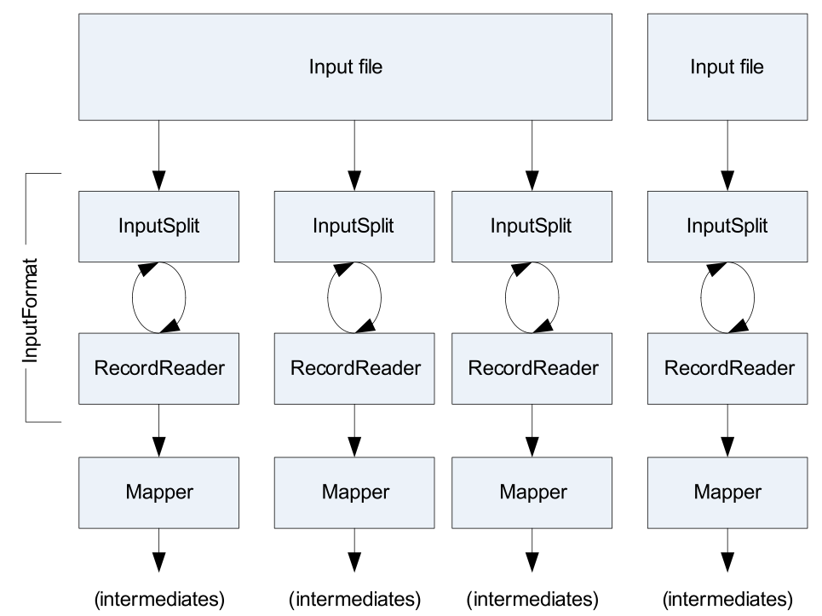
The MapReduce Flow: The Mapper

Slide 74
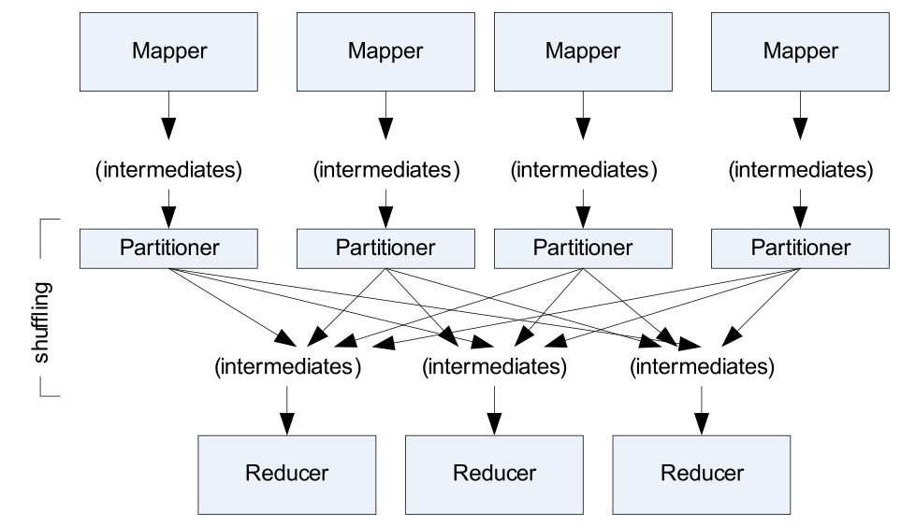
The MapReduce Flow: Shuffle and Sort

Slide 75
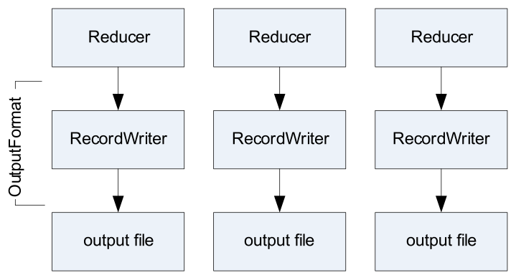
The MapReduce Flow: Reducers to Outputs

Slide 76
Our MapReduce Program: WordCount
To investigate the API, we will dissect the WordCount program you ran in the previous chapter
This consists of three portions
The driver code
Code that runs on the client to configure and submit the job
The Mapper
The Reducer
Before we look at the code, we need to cover some basic Hadoop API concepts

Slide 77
Getting Data to the Mapper
The data passed to the Mapper is specified by an InputFormat
Specified in the driver code
Defines the location of the input data
A file or directory, for example
Determines how to split the input data into input splits
Each Mapper deals with a single input split
InputFormat is a factory for RecordReader objects to extract (key, value) records from the input source

Slide 78
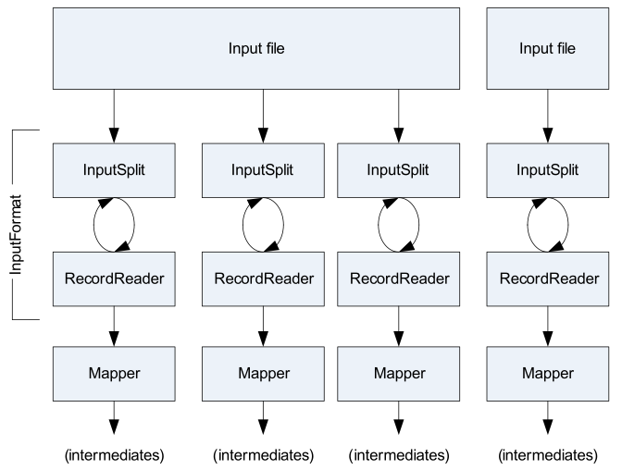
Getting Data to the Mapper (cont’d)

Slide 79
Some Standard InputFormats
FileInputFormat
The base class used for all file-based InputFormats
TextInputFormat
The default
Treats each \n-terminated line of a file as a value
Key is the byte offset within the file of that line
KeyValueTextInputFormat
Maps \n-terminated lines as ‘key SEP value’
By default, separator is a tab
SequenceFileInputFormat
Binary file of (key, value) pairs with some additional metadata
SequenceFileAsTextInputFormat
Similar, but maps (key.toString(), value.toString())

Slide 80
Keys and Values are Objects
Keys and values in Hadoop are Objects
Values are objects which implement Writable
Keys are objects which implement WritableComparable

Slide 81
What is Writable?
Hadoop defines its own ‘box classes’ for strings, integers and so on
IntWritable for ints
LongWritable for longs
FloatWritable for floats
DoubleWritable for doubles
Text for strings
Etc.
The Writable interface makes serialization quick and easy for Hadoop
Any value’s type must implement the Writable interface

Slide 82
What is WritableComparable?
A WritableComparable is a Writable which is also Comparable
Two WritableComparables can be compared against each other to determine their ‘order’
Keys must be WritableComparables because they are passed to the Reducer in sorted order
Note that despite their names, all Hadoop box classes implement both Writable and WritableComparable
For example, IntWritable is actually a WritableComparable

Slide 83
The Driver Code: Introduction
The driver code runs on the client machine
It configures the job, then submits it to the cluster

Slide 84
The Driver: Complete Code
import org.apache.hadoop.fs.Path;
import org.apache.hadoop.io.IntWritable;
import org.apache.hadoop.io.Text;
import org.apache.hadoop.mapred.FileInputFormat;
import org.apache.hadoop.mapred.FileOutputFormat;
import org.apache.hadoop.mapred.JobClient;
import org.apache.hadoop.mapred.JobConf;
import org.apache.hadoop.conf.Configured;
import org.apache.hadoop.util.Tool;
import org.apache.hadoop.util.ToolRunner;
public class WordCount extends Configured implements Tool {
public int run(String[] args) throws Exception {
if (args.length != 2) {
System.out.printf(
"Usage: %s [generic options] <input dir> <output dir>\n",
getClass().getSimpleName());
ToolRunner.printGenericCommandUsage(System.out);
return -1;
}
JobConf conf = new JobConf(getConf(), WordCount.class);
conf.setJobName(this.getClass().getName());
FileInputFormat.setInputPaths(conf, new Path(args[0]));
FileOutputFormat.setOutputPath(conf, new Path(args[1]));
conf.setMapperClass(WordMapper.class);
conf.setReducerClass(SumReducer.class);

Slide 85
The Driver: Complete Code (cont’d)
conf.setMapOutputKeyClass(Text.class);
conf.setMapOutputValueClass(IntWritable.class);
conf.setOutputKeyClass(Text.class);
conf.setOutputValueClass(IntWritable.class);
JobClient.runJob(conf);
return 0;
}
public static void main(String[] args) throws Exception {
int exitCode = ToolRunner.run(new WordCount(), args);
System.exit(exitCode);
}
}

Slide 86
The Driver: Import Statements
import org.apache.hadoop.fs.Path;
import org.apache.hadoop.io.IntWritable;
import org.apache.hadoop.io.Text;
import org.apache.hadoop.mapred.FileInputFormat;
import org.apache.hadoop.mapred.FileOutputFormat;
import org.apache.hadoop.mapred.JobClient;
import org.apache.hadoop.mapred.JobConf;
import org.apache.hadoop.conf.Configured;
import org.apache.hadoop.util.Tool;
import org.apache.hadoop.util.ToolRunner;
public class WordCount extends Configured implements Tool {
public int run(String[] args) throws Exception {
if (args.length != 2) {
System.out.printf(
"Usage: %s [generic options] <input dir> <output dir>\n",
getClass().getSimpleName());
ToolRunner.printGenericCommandUsage(System.out);
return -1;
}
JobConf conf = new JobConf(getConf(), WordCount.class);
conf.setJobName(this.getClass().getName());
FileInputFormat.setInputPaths(conf, new Path(args[0]));
FileOutputFormat.setOutputPath(conf, new Path(args[1]));
conf.setMapperClass(WordMapper.class);
conf.setReducerClass(SumReducer.class);
You will typically import these classes into every
MapReduce job you write. We will omit the import
statements in future slides for brevity.

Slide 87
The Driver: Main Code
public class WordCount extends Configured implements Tool {
public int run(String[] args) throws Exception {
if (args.length != 2) {
System.out.printf(
"Usage: %s [generic options] <input dir> <output dir>\n", getClass().getSimpleName());
ToolRunner.printGenericCommandUsage(System.out);
return -1;
}
JobConf conf = new JobConf(getConf(), WordCount.class);
conf.setJobName(this.getClass().getName());
FileInputFormat.setInputPaths(conf, new Path(args[0]));
FileOutputFormat.setOutputPath(conf, new Path(args[1]));
conf.setMapperClass(WordMapper.class);
conf.setReducerClass(SumReducer.class);
conf.setMapOutputKeyClass(Text.class);
conf.setMapOutputValueClass(IntWritable.class);
conf.setOutputKeyClass(Text.class);
conf.setOutputValueClass(IntWritable.class);
JobClient.runJob(conf);
return 0;
}
public static void main(String[] args) throws Exception {
int exitCode = ToolRunner.run(new WordCount(), args);
System.exit(exitCode);
}
}

Slide 88
The Driver Class: Using ToolRunner
public class WordCount extends Configured implements Tool {
public int run(String[] args) throws Exception {
if (args.length != 2) {
System.out.printf(
"Usage: %s [generic options] <input dir> <output dir>\n", getClass().getSimpleName());
ToolRunner.printGenericCommandUsage(System.out);
return -1;
}
JobConf conf = new JobConf(getConf(), WordCount.class);
conf.setJobName(this.getClass().getName());
FileInputFormat.setInputPaths(conf, new Path(args[0]));
FileOutputFormat.setOutputPath(conf, new Path(args[1]));
conf.setMapperClass(WordMapper.class);
conf.setReducerClass(SumReducer.class);
conf.setMapOutputKeyClass(Text.class);
conf.setMapOutputValueClass(IntWritable.class);
conf.setOutputKeyClass(Text.class);
conf.setOutputValueClass(IntWritable.class);
JobClient.runJob(conf);
return 0;
}
public static void main(String[] args) throws Exception {
int exitCode = ToolRunner.run(new WordCount(), args);
System.exit(exitCode);
}
}
Your driver class extends configured and implements Tool. This allows the user to specify configuration settings on the command line, which will then be incorporated into the job’s configuration when it is submitted to the server. Although this is not compulsory, it is considered a best practice. (We will discuss ToolRunner in more detail later.)

Slide 89
The Driver Class: Using ToolRunner (cont’d)
public class WordCount extends Configured implements Tool {
public int run(String[] args) throws Exception {
if (args.length != 2) {
System.out.printf(
"Usage: %s [generic options] <input dir> <output dir>\n", getClass().getSimpleName());
ToolRunner.printGenericCommandUsage(System.out);
return -1;
}
JobConf conf = new JobConf(getConf(), WordCount.class);
conf.setJobName(this.getClass().getName());
FileInputFormat.setInputPaths(conf, new Path(args[0]));
FileOutputFormat.setOutputPath(conf, new Path(args[1]));
conf.setMapperClass(WordMapper.class);
conf.setReducerClass(SumReducer.class);
conf.setMapOutputKeyClass(Text.class);
conf.setMapOutputValueClass(IntWritable.class);
conf.setOutputKeyClass(Text.class);
conf.setOutputValueClass(IntWritable.class);
JobClient.runJob(conf);
return 0;
}
public static void main(String[] args) throws Exception {
int exitCode = ToolRunner.run(new WordCount(), args);
System.exit(exitCode);
}
}
The main method simply calls ToolRubber.run(). Passing in the driver class and the command-line arguments. The job will then be configured and submitted in the run method.

Slide 90
Sanity Checking The Job’s Invocation
public class WordCount extends Configured implements Tool {
public int run(String[] args) throws Exception {
if (args.length != 2) {
System.out.printf(
"Usage: %s [generic options] <input dir> <output dir>\n", getClass().getSimpleName());
ToolRunner.printGenericCommandUsage(System.out);
return -1;
}
JobConf conf = new JobConf(getConf(), WordCount.class);
conf.setJobName(this.getClass().getName());
FileInputFormat.setInputPaths(conf, new Path(args[0]));
FileOutputFormat.setOutputPath(conf, new Path(args[1]));
conf.setMapperClass(WordMapper.class);
conf.setReducerClass(SumReducer.class);
conf.setMapOutputKeyClass(Text.class);
conf.setMapOutputValueClass(IntWritable.class);
conf.setOutputKeyClass(Text.class);
conf.setOutputValueClass(IntWritable.class);
JobClient.runJob(conf);
return 0;
}
public static void main(String[] args) throws Exception {
int exitCode = ToolRunner.run(new WordCount(), args);
System.exit(exitCode);
}
}
The first step is to ensure that we have been given two command-line arguments. If not, print a help message and exit.

Slide 91
Configuring The Job With JobConf
public class WordCount extends Configured implements Tool {
public int run(String[] args) throws Exception {
if (args.length != 2) {
System.out.printf(
"Usage: %s [generic options] <input dir> <output dir>\n", getClass().getSimpleName());
ToolRunner.printGenericCommandUsage(System.out);
return -1;
}
JobConf conf = new JobConf(getConf(), WordCount.class);
conf.setJobName(this.getClass().getName());
FileInputFormat.setInputPaths(conf, new Path(args[0]));
FileOutputFormat.setOutputPath(conf, new Path(args[1]));
conf.setMapperClass(WordMapper.class);
conf.setReducerClass(SumReducer.class);
conf.setMapOutputKeyClass(Text.class);
conf.setMapOutputValueClass(IntWritable.class);
conf.setOutputKeyClass(Text.class);
conf.setOutputValueClass(IntWritable.class);
JobClient.runJob(conf);
return 0;
}
public static void main(String[] args) throws Exception {
int exitCode = ToolRunner.run(new WordCount(), args);
System.exit(exitCode);
}
}
To configure the job, create a new JobConf object and specify the class which will lbe called to run the job.

Slide 92
Creating a New JobConf Object
The JobConf class allows you to set configuration options for your MapReduce job
The classes to be used for your Mapper and Reducer
The input and output directories
Many other options
Any options not explicitly set in your driver code will be read from your Hadoop configuration files
Usually located in /etc/hadoop/conf
Any options not specified in your configuration files will receive Hadoop’s default values

Slide 93
Naming The Job
public class WordCount extends Configured implements Tool {
public int run(String[] args) throws Exception {
if (args.length != 2) {
System.out.printf(
"Usage: %s [generic options] <input dir> <output dir>\n", getClass().getSimpleName());
ToolRunner.printGenericCommandUsage(System.out);
return -1;
}
JobConf conf = new JobConf(getConf(), WordCount.class);
conf.setJobName(this.getClass().getName());
FileInputFormat.setInputPaths(conf, new Path(args[0]));
FileOutputFormat.setOutputPath(conf, new Path(args[1]));
conf.setMapperClass(WordMapper.class);
conf.setReducerClass(SumReducer.class);
conf.setMapOutputKeyClass(Text.class);
conf.setMapOutputValueClass(IntWritable.class);
conf.setOutputKeyClass(Text.class);
conf.setOutputValueClass(IntWritable.class);
JobClient.runJob(conf);
return 0;
}
public static void main(String[] args) throws Exception {
int exitCode = ToolRunner.run(new WordCount(), args);
System.exit(exitCode);
}
}
Give the job a meaningful name.

Slide 94
Specifying Input and Output Directories
public class WordCount extends Configured implements Tool {
public int run(String[] args) throws Exception {
if (args.length != 2) {
System.out.printf(
"Usage: %s [generic options] <input dir> <output dir>\n", getClass().getSimpleName());
ToolRunner.printGenericCommandUsage(System.out);
return -1;
}
JobConf conf = new JobConf(getConf(), WordCount.class);
conf.setJobName(this.getClass().getName());
FileInputFormat.setInputPaths(conf, new Path(args[0]));
FileOutputFormat.setOutputPath(conf, new Path(args[1]));
conf.setMapperClass(WordMapper.class);
conf.setReducerClass(SumReducer.class);
conf.setMapOutputKeyClass(Text.class);
conf.setMapOutputValueClass(IntWritable.class);
conf.setOutputKeyClass(Text.class);
conf.setOutputValueClass(IntWritable.class);
JobClient.runJob(conf);
return 0;
}
public static void main(String[] args) throws Exception {
int exitCode = ToolRunner.run(new WordCount(), args);
System.exit(exitCode);
}
}
Next, specify the input directory from which data will be read, and the output directory to which final output will be written.

Slide 95
Specifying the InputFormat
The default InputFormat (TextInputFormat) will be used unless you specify otherwise
To use an InputFormat other than the default, use e.g.
conf.setInputFormat(KeyValueTextInputFormat.class)

Slide 96
Determining Which Files To Read
By default, FileInputFormat.setInputPaths() will read all files from a specified directory and send them to Mappers
Exceptions: items whose names begin with a period (.) or underscore (_)
Globs can be specified to restrict input
For example, /2010/*/01/*
Alternatively, FileInputFormat.addInputPath() can be called multiple times, specifying a single file or directory each time
More advanced filtering can be performed by implementing a PathFilter
Interface with a method named accept
Takes a path to a file, returns true or false depending on whether or not the file should be processed

Slide 97
Specifying Final Output With OutputFormat
FileOutputFormat.setOutputPath() specifies the directory to which the Reducers will write their final output
The driver can also specify the format of the output data
Default is a plain text file
Could be explicitly written as
conf.setOutputFormat(TextOutputFormat.class);

Slide 98
Specify The Classes for Mapper and Reducer
public class WordCount extends Configured implements Tool {
public int run(String[] args) throws Exception {
if (args.length != 2) {
System.out.printf(
"Usage: %s [generic options] <input dir> <output dir>\n", getClass().getSimpleName());
ToolRunner.printGenericCommandUsage(System.out);
return -1;
}
JobConf conf = new JobConf(getConf(), WordCount.class);
conf.setJobName(this.getClass().getName());
FileInputFormat.setInputPaths(conf, new Path(args[0]));
FileOutputFormat.setOutputPath(conf, new Path(args[1]));
conf.setMapperClass(WordMapper.class);
conf.setReducerClass(SumReducer.class);
conf.setMapOutputKeyClass(Text.class);
conf.setMapOutputValueClass(IntWritable.class);
conf.setOutputKeyClass(Text.class);
conf.setOutputValueClass(IntWritable.class);
JobClient.runJob(conf);
return 0;
}
public static void main(String[] args) throws Exception {
int exitCode = ToolRunner.run(new WordCount(), args);
System.exit(exitCode);
}
}
Give the JobConf object information about which classes are to be instantiated as the Mapper and Reducer.

Slide 99
Specify The Intermediate Data Types
public class WordCount extends Configured implements Tool {
public int run(String[] args) throws Exception {
if (args.length != 2) {
System.out.printf(
"Usage: %s [generic options] <input dir> <output dir>\n", getClass().getSimpleName());
ToolRunner.printGenericCommandUsage(System.out);
return -1;
}
JobConf conf = new JobConf(getConf(), WordCount.class);
conf.setJobName(this.getClass().getName());
FileInputFormat.setInputPaths(conf, new Path(args[0]));
FileOutputFormat.setOutputPath(conf, new Path(args[1]));
conf.setMapperClass(WordMapper.class);
conf.setReducerClass(SumReducer.class);
conf.setMapOutputKeyClass(Text.class);
conf.setMapOutputValueClass(IntWritable.class);
conf.setOutputKeyClass(Text.class);
conf.setOutputValueClass(IntWritable.class);
JobClient.runJob(conf);
return 0;
}
public static void main(String[] args) throws Exception {
int exitCode = ToolRunner.run(new WordCount(), args);
System.exit(exitCode);
}
}
Specify the types of the intermediate output key and value produced by the Mapper.

Slide 100
Specify The Final Output Data Types
public class WordCount extends Configured implements Tool {
public int run(String[] args) throws Exception {
if (args.length != 2) {
System.out.printf(
"Usage: %s [generic options] <input dir> <output dir>\n", getClass().getSimpleName());
ToolRunner.printGenericCommandUsage(System.out);
return -1;
}
JobConf conf = new JobConf(getConf(), WordCount.class);
conf.setJobName(this.getClass().getName());
FileInputFormat.setInputPaths(conf, new Path(args[0]));
FileOutputFormat.setOutputPath(conf, new Path(args[1]));
conf.setMapperClass(WordMapper.class);
conf.setReducerClass(SumReducer.class);
conf.setMapOutputKeyClass(Text.class);
conf.setMapOutputValueClass(IntWritable.class);
conf.setOutputKeyClass(Text.class);
conf.setOutputValueClass(IntWritable.class);
JobClient.runJob(conf);
return 0;
}
public static void main(String[] args) throws Exception {
int exitCode = ToolRunner.run(new WordCount(), args);
System.exit(exitCode);
}
}
Specify the types of the Reducer’s output key and value.

Slide 101
Running The Job
public class WordCount extends Configured implements Tool {
public int run(String[] args) throws Exception {
if (args.length != 2) {
System.out.printf(
"Usage: %s [generic options] <input dir> <output dir>\n", getClass().getSimpleName());
ToolRunner.printGenericCommandUsage(System.out);
return -1;
}
JobConf conf = new JobConf(getConf(), WordCount.class);
conf.setJobName(this.getClass().getName());
FileInputFormat.setInputPaths(conf, new Path(args[0]));
FileOutputFormat.setOutputPath(conf, new Path(args[1]));
conf.setMapperClass(WordMapper.class);
conf.setReducerClass(SumReducer.class);
conf.setMapOutputKeyClass(Text.class);
conf.setMapOutputValueClass(IntWritable.class);
conf.setOutputKeyClass(Text.class);
conf.setOutputValueClass(IntWritable.class);
JobClient.runJob(conf);
return 0;
}
public static void main(String[] args) throws Exception {
int exitCode = ToolRunner.run(new WordCount(), args);
System.exit(exitCode);
}
}
Specify the types of the Reducer’s output key and value.

Slide 102
Running The Job (cont’d)
There are two ways to run your MapReduce job:
JobClient.runJob(conf)
Blocks (waits for the job to complete before continuing)
JobClient.submitJob(conf)
Does not block (driver code continues as the job is running)
JobClient determines the proper division of input data into InputSplits
JobClient then sends the job information to the JobTracker daemon on the cluster

Slide 103
Reprise: Driver Code
public class WordCount extends Configured implements Tool {
public int run(String[] args) throws Exception {
if (args.length != 2) {
System.out.printf(
"Usage: %s [generic options] <input dir> <output dir>\n", getClass().getSimpleName());
ToolRunner.printGenericCommandUsage(System.out);
return -1;
}
JobConf conf = new JobConf(getConf(), WordCount.class);
conf.setJobName(this.getClass().getName());
FileInputFormat.setInputPaths(conf, new Path(args[0]));
FileOutputFormat.setOutputPath(conf, new Path(args[1]));
conf.setMapperClass(WordMapper.class);
conf.setReducerClass(SumReducer.class);
conf.setMapOutputKeyClass(Text.class);
conf.setMapOutputValueClass(IntWritable.class);
conf.setOutputKeyClass(Text.class);
conf.setOutputValueClass(IntWritable.class);
JobClient.runJob(conf);
return 0;
}
public static void main(String[] args) throws Exception {
int exitCode = ToolRunner.run(new WordCount(), args);
System.exit(exitCode);
}
}

Slide 104
The Mapper: Complete Code
import java.io.IOException;
import org.apache.hadoop.io.IntWritable;
import org.apache.hadoop.io.LongWritable;
import org.apache.hadoop.io.Text;
import org.apache.hadoop.mapred.MapReduceBase;
import org.apache.hadoop.mapred.Mapper;
import org.apache.hadoop.mapred.OutputCollector;
import org.apache.hadoop.mapred.Reporter;
public class WordMapper extends MapReduceBase implements
Mapper<LongWritable, Text, Text, IntWritable> {
public void map(LongWritable key, Text value,
OutputCollector<Text, IntWritable> output, Reporter reporter)
throws IOException {
String s = value.toString();
for (String word : s.split("\\W+")) {
if (word.length() > 0) {
output.collect(new Text(word), new IntWritable(1));
}
}
}
}

Slide 105
The Mapper: import Statements
import java.io.IOException;
import org.apache.hadoop.io.IntWritable;
import org.apache.hadoop.io.LongWritable;
import org.apache.hadoop.io.Text;
import org.apache.hadoop.mapred.MapReduceBase;
import org.apache.hadoop.mapred.Mapper;
import org.apache.hadoop.mapred.OutputCollector;
import org.apache.hadoop.mapred.Reporter;
public class WordMapper extends MapReduceBase implements
Mapper<LongWritable, Text, Text, IntWritable> {
public void map(LongWritable key, Text value,
OutputCollector<Text, IntWritable> output, Reporter reporter)
throws IOException {
String s = value.toString();
for (String word : s.split("\\W+")) {
if (word.length() > 0) {
output.collect(new Text(word), new IntWritable(1));
}
}
}
}
You will typically import java.io.IOException, and the org.apache.hadoop classes shown, in every Mapper you write. We will omit the import statements in future slides for brevity.

Slide 106
The Mapper: Main Code
public class WordMapper extends MapReduceBase
implements Mapper<LongWritable, Text, Text, IntWritable> {
public void map(LongWritable key, Text value,
OutputCollector<Text, IntWritable> output, Reporter reporter)
throws IOException {
String s = value.toString();
for (String word : s.split("\\W+")) {
if (word.length() > 0) {
output.collect(new Text(word), new IntWritable(1));
}
}
}
}

Slide 107
The Mapper: Main Code (cont’d)
public class WordMapper extends MapReduceBase
implements Mapper<LongWritable, Text, Text, IntWritable> {
public void map(LongWritable key, Text value,
OutputCollector<Text, IntWritable> output, Reporter reporter)
throws IOException {
String s = value.toString();
for (String word : s.split("\\W+")) {
if (word.length() > 0) {
output.collect(new Text(word), new IntWritable(1));
}
}
}
}
Your Mapper class should extend MapReduceBase, and implement the Mapper interface. The Mapper interface expects four generics, which define the types of the input and output key/value pairs. The first two parameters define the input key and value types, the second two define the output key and value types.

Slide 108
The map Method
public class WordMapper extends MapReduceBase
implements Mapper<LongWritable, Text, Text, IntWritable> {
public void map(LongWritable key, Text value,
OutputCollector<Text, IntWritable> output, Reporter reporter)
throws IOException {
String s = value.toString();
for (String word : s.split("\\W+")) {
if (word.length() > 0) {
output.collect(new Text(word), new IntWritable(1));
}
}
}
}
The map method’s signature looks like this. It will be passed a key, a value, an OutputCollector object and a Reporter object. The OutputCollector is used to write the intermediate data; you must specify the data types that it will write.

Slide 109
The map Method: Processing The Line
public class WordMapper extends MapReduceBase
implements Mapper<LongWritable, Text, Text, IntWritable> {
public void map(LongWritable key, Text value,
OutputCollector<Text, IntWritable> output, Reporter reporter)
throws IOException {
String s = value.toString();
for (String word : s.split("\\W+")) {
if (word.length() > 0) {
output.collect(new Text(word), new IntWritable(1));
}
}
}
}
value is a Text object, so we retrieve the string it contains.

Slide 110
The map Method: Processing The Line (cont’d)
public class WordMapper extends MapReduceBase
implements Mapper<LongWritable, Text, Text, IntWritable> {
public void map(LongWritable key, Text value,
OutputCollector<Text, IntWritable> output, Reporter reporter)
throws IOException {
String s = value.toString();
for (String word : s.split("\\W+")) {
if (word.length() > 0) {
output.collect(new Text(word), new IntWritable(1));
}
}
}
}
We then split the string up into words using any nonalphanumeric characters as the word delimiter, and loop through those words.

Slide 111
Outputting Intermediate Data
public class WordMapper extends MapReduceBase
implements Mapper<LongWritable, Text, Text, IntWritable> {
public void map(LongWritable key, Text value,
OutputCollector<Text, IntWritable> output, Reporter reporter)
throws IOException {
String s = value.toString();
for (String word : s.split("\\W+")) {
if (word.length() > 0) {
output.collect(new Text(word), new IntWritable(1));
}
}
}
}
To emit a (key, value) pair, we call the collect method of our OutputCollector object. The key will be the word itself, the value will be the number 1. Recall that the output key must be of type WritableComparable, and the value must be a Writable.

Slide 112
Reprise: The Map Method
public class WordMapper extends MapReduceBase
implements Mapper<LongWritable, Text, Text, IntWritable> {
public void map(LongWritable key, Text value,
OutputCollector<Text, IntWritable> output, Reporter reporter)
throws IOException {
String s = value.toString();
for (String word : s.split("\\W+")) {
if (word.length() > 0) {
output.collect(new Text(word), new IntWritable(1));
}
}
}
}

Slide 113
The Reporter Object
Notice that in this example we have not used the Reporter object which was passed to the Mapper
The Reporter object can be used to pass some information back to the driver code
We will investigate the Reporter later in the course

Slide 114
The Reducer: Complete Code
import java.io.IOException;
import java.util.Iterator;
import org.apache.hadoop.io.IntWritable;
import org.apache.hadoop.io.Text;
import org.apache.hadoop.mapred.OutputCollector;
import org.apache.hadoop.mapred.MapReduceBase;
import org.apache.hadoop.mapred.Reducer;
import org.apache.hadoop.mapred.Reporter;
public class SumReducer extends MapReduceBase implements
Reducer<Text, IntWritable, Text, IntWritable> {
public void reduce(Text key, Iterator<IntWritable> values,
OutputCollector<Text, IntWritable> output, Reporter reporter)
throws IOException {
int wordCount = 0;
while (values.hasNext()) {
IntWritable value = values.next();
wordCount += value.get();
}
output.collect(key, new IntWritable(wordCount));
}
}

Slide 115
The Reducer: Import Statements
import java.io.IOException;
import java.util.Iterator;
import org.apache.hadoop.io.IntWritable;
import org.apache.hadoop.io.Text;
import org.apache.hadoop.mapred.OutputCollector;
import org.apache.hadoop.mapred.MapReduceBase;
import org.apache.hadoop.mapred.Reducer;
import org.apache.hadoop.mapred.Reporter;
public class SumReducer extends MapReduceBase implements
Reducer<Text, IntWritable, Text, IntWritable> {
public void reduce(Text key, Iterator<IntWritable> values,
OutputCollector<Text, IntWritable> output, Reporter reporter)
throws IOException {
int wordCount = 0;
while (values.hasNext()) {
IntWritable value = values.next();
wordCount += value.get();
}
output.collect(key, new IntWritable(wordCount));
}
}
As with the Mapper, you will typically import java.io.IOException, and the org.apache.hadoop classes shown, in every Reducer you write. You will also import java.util.Iterator, which will be used to step through the values provided to the Reducer for each key. We will omit the import statements in future slides for brevity.

Slide 116
The Reducer: Main Code
public class SumReducer extends MapReduceBase implements
Reducer<Text, IntWritable, Text, IntWritable> {
public void reduce(Text key, Iterator<IntWritable> values,
OutputCollector<Text, IntWritable> output, Reporter reporter)
throws IOException {
int wordCount = 0;
while (values.hasNext()) {
IntWritable value = values.next();
wordCount += value.get();
}
output.collect(key, new IntWritable(wordCount));
}
}

Slide 117
The Reducer: Main Code (cont’d)
public class SumReducer extends MapReduceBase implements
Reducer<Text, IntWritable, Text, IntWritable> {
public void reduce(Text key, Iterator<IntWritable> values,
OutputCollector<Text, IntWritable> output, Reporter reporter)
throws IOException {
int wordCount = 0;
while (values.hasNext()) {
IntWritable value = values.next();
wordCount += value.get();
}
output.collect(key, new IntWritable(wordCount));
}
}
Your Reducer class should extend MapReduceBase and implement Reducer. The Reducer interface expects four generics, which define the types of the input and output key/value pairs. The first two parameters define the intermediate key and value types, the second two define the final output key and value types. The keys are WritableComparables, the values are Writables.

Slide 118
The reduce Method
public class SumReducer extends MapReduceBase implements
Reducer<Text, IntWritable, Text, IntWritable> {
public void reduce(Text key, Iterator<IntWritable> values,
OutputCollector<Text, IntWritable> output, Reporter reporter)
throws IOException {
int wordCount = 0;
while (values.hasNext()) {
IntWritable value = values.next();
wordCount += value.get();
}
output.collect(key, new IntWritable(wordCount));
}
}
The reduce method receives a key and an Iterator of values; it also receives an OutputCollector object and a Reporter object.

Slide 119
Processing The Values
public class SumReducer extends MapReduceBase implements
Reducer<Text, IntWritable, Text, IntWritable> {
public void reduce(Text key, Iterator<IntWritable> values,
OutputCollector<Text, IntWritable> output, Reporter reporter)
throws IOException {
int wordCount = 0;
while (values.hasNext()) {
IntWritable value = values.next();
wordCount += value.get();
}
output.collect(key, new IntWritable(wordCount));
}
}
We use the hasNext() and next() methods on values to step through all the elements in the iterator. In our example, we are merely adding all the values together. We use value().get() to retrieve the actual numeric value.

Slide 120
Writing The Final Output
public class SumReducer extends MapReduceBase implements
Reducer<Text, IntWritable, Text, IntWritable> {
public void reduce(Text key, Iterator<IntWritable> values,
OutputCollector<Text, IntWritable> output, Reporter reporter)
throws IOException {
int wordCount = 0;
while (values.hasNext()) {
IntWritable value = values.next();
wordCount += value.get();
}
output.collect(key, new IntWritable(wordCount));
}
}
Finally, we write the output (key, value) pair using the collect method of our OutputCollector object.

Slide 121
Reprise: The Reduce Method
public class SumReducer extends MapReduceBase implements
Reducer<Text, IntWritable, Text, IntWritable> {
public void reduce(Text key, Iterator<IntWritable> values,
OutputCollector<Text, IntWritable> output, Reporter reporter)
throws IOException {
int wordCount = 0;
while (values.hasNext()) {
IntWritable value = values.next();
wordCount += value.get();
}
output.collect(key, new IntWritable(wordCount));
}
}

